Slide 1


PERSONALIZED MOVIE RECOMMENDATION SYSTEM
TEAM :- GUIDO PRADO TANMAY REWARI VINAY KHANDELWAL

Slide 2

OBJECTIVE
The objective of our Big Data project is to develop an advanced and comprehensive movie recommendation system that leverages four distinct filtering algorithms, namely Collaborative Filtering, Content-Based Filtering (Genre), Age-Based Filtering, and Occupation-Based Filtering. Our goal is to enhance the accuracy and personalization of movie recommendations by analyzing user behavior patterns across these diverse dimensions. Through the integration of these four filtering models, we aim to create a hybrid recommendation system that combines their strengths in a weighted manner. This approach involves assigning specific weights to each filtering model, ensuring a nuanced and tailored movie recommendation for users. By fusing collaborative, content-based, age-based, and occupation-based filtering techniques, our system seeks to provide a holistic and effective solution for predicting and satisfying user preferences in the realm of movie selection.

Slide 3

In a landscape inundated with an expanding array of entertainment choices, the quest for personalized and enjoyable content experiences has never been more relevant. Our drive originates from the ambition to reshape how users explore and engage with movies. Traditional recommendation systems often fall short in capturing the subtleties of individual preferences. We embark on this project with the aim of bridging this gap, creating a solution that goes beyond the limitations of single algorithms.
Our inspiration comes from the belief that a comprehensive strategy, encompassing Collaborative Filtering, Content-Based Filtering (Genre), Age-Based Filtering, and Occupation-Based Filtering, has the potential to unlock a new level of precision in movie recommendations. The synthesis of these varied filtering models, culminating in a hybrid system with weighted components, reflects our response to the evolving needs of users who seek not just recommendations but personalized suggestions aligned with their unique tastes, demographics, and interests.
Through this initiative, we aspire to contribute to the advancement of recommendation systems, envisioning a future where users experience a more personalized and enjoyable cinematic journey. Our motivation lies in the opportunity to redefine how individuals discover and connect with movies, offering a tailored experience that transcends the conventional boundaries of recommendation technology.

Slide 4


Slide 5

Exploratory Data Analysis
Here's some content for our Exploratory Data Analysis:-
1. Dominant Production Company:
Our analysis revealed that Warner Bros. stands out as the top production company, consistently contributing significantly to the cinematic landscape. This dominance may indicate the studio's enduring impact on the film industry, influencing both quality and quantity in movie production.
2. Runtime Trends:
The majority of movies in our dataset exhibit a runtime of less than 200 minutes. This finding aligns with industry standards, suggesting that filmmakers generally adhere to a preferred duration that caters to audience preferences and viewing habits. This insight can guide content creators in optimizing movie lengths for broad audience appeal.

Slide 6
3. Exponential Growth in Movie Releases (2000-2020):
One of the most noteworthy trends identified in our analysis is the exponential growth in the number of movies released from 2000 to 2020. This period witnessed a surge in cinematic output, reflecting the dynamic nature of the film industry. Factors such as technological advancements, increased accessibility, and a growing global audience may contribute to this significant expansion. Understanding this trend can provide valuable insights for industry stakeholders, including filmmakers, distributors, and investors, as they navigate the evolving landscape of film production and distribution.
4. Comparative Period Analysis:
Comparing the number of movie releases across different periods, the data suggests that the 2000-2020 timeframe has experienced unparalleled growth compared to other periods. This shift may be attributed to various factors, including changes in consumer behavior, advancements in digital platforms, and the globalization of the film industry. Analyzing these patterns can offer valuable strategic insights for stakeholders aiming to navigate and capitalize on the evolving dynamics of the movie market.

Slide 7
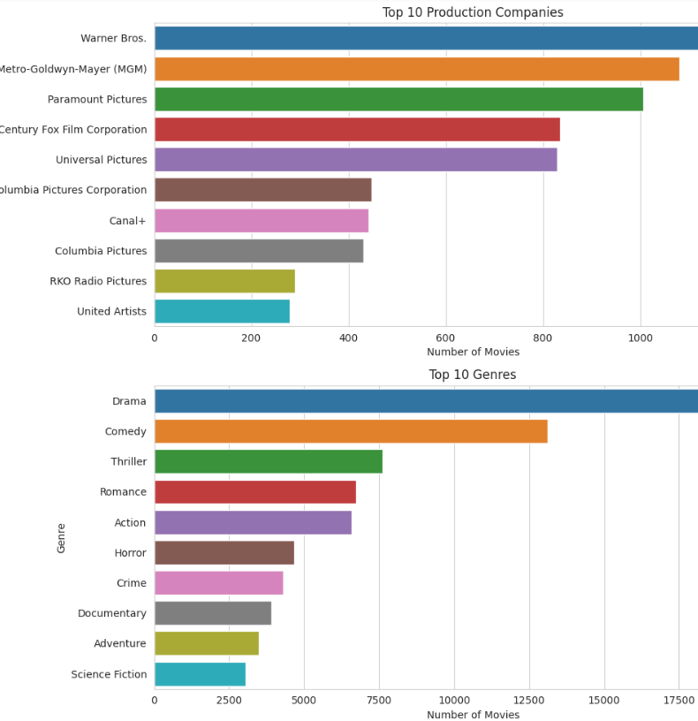
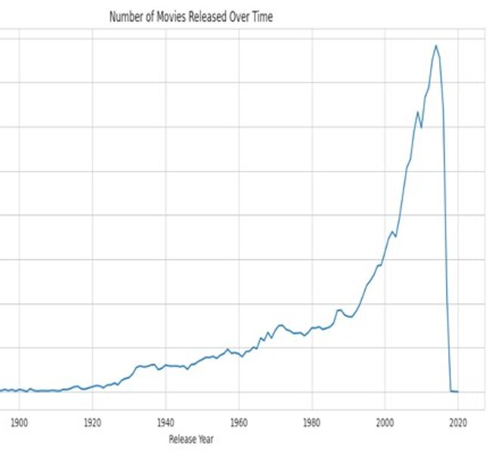
VISUALIZATIONS

Slide 8
Collaborative Filtering
Collaborative Filtering is a pivotal component of our movie recommendation system, offering a powerful method for predicting a user's preferences based on the preferences and behavior of similar users. This technique relies on the collective wisdom of the user community, recognizing patterns and similarities to make informed predictions about movie choices.
In our movie recommendation project, Collaborative Filtering plays a crucial role in understanding and predicting user preferences. By harnessing the collective wisdom of the user community, we aim to deliver accurate and personalized movie recommendations, enhancing the overall user experience.

Slide 9
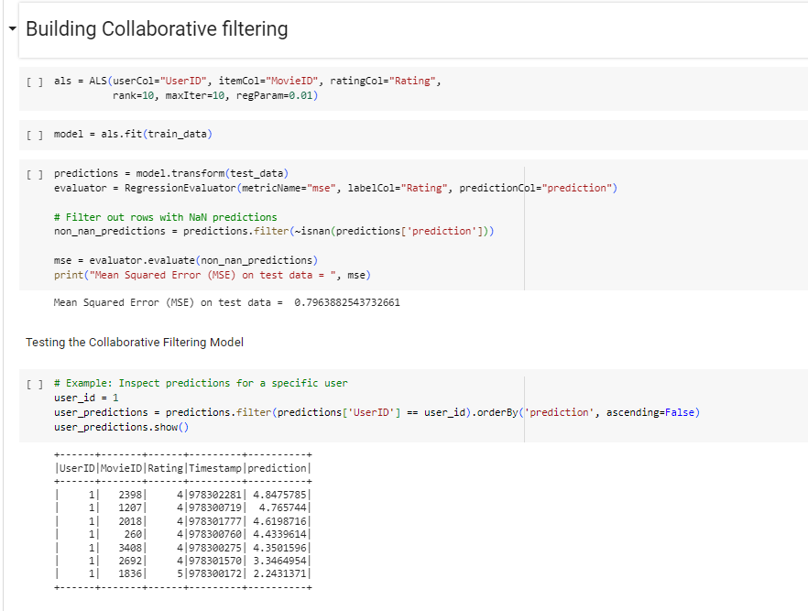
IMPLEMENTATION OF COLABORATIVE FILTERING
ALS (Alternating Least Squares) serves as the backbone of our collaborative filtering approach in the movie recommendation system. This algorithm excels in capturing complex user-item interactions through matrix factorization. By decomposing the user-item interaction matrix into lower-rank matrices representing users and items, ALS reveals latent factors that drive personalized recommendations. Implemented using the PySpark ML library, our ALS model is trained on historical user-item interactions, and predictions for unseen pairs are generated with the transform method. The model's performance is evaluated using a Regression Evaluator, employing the Mean Squared Error (MSE) metric on test data. ALS empowers our system to deliver user-specific recommendations, enriching the overall movie-watching experience with accurate and tailored suggestions.

Slide 10

CONTENT BASED FILTERING
Content-Based Filtering is a key element in our movie recommendation system, offering a personalized approach by analyzing the intrinsic features of movies and matching them to user preferences. Unlike Collaborative Filtering, which relies on user behavior, Content-Based Filtering focuses on the characteristics of the items themselves to make recommendations.
In our movie recommendation system, we've divided content-based filtering into three key dimensions: Genre, Age, and Occupation.

Slide 11
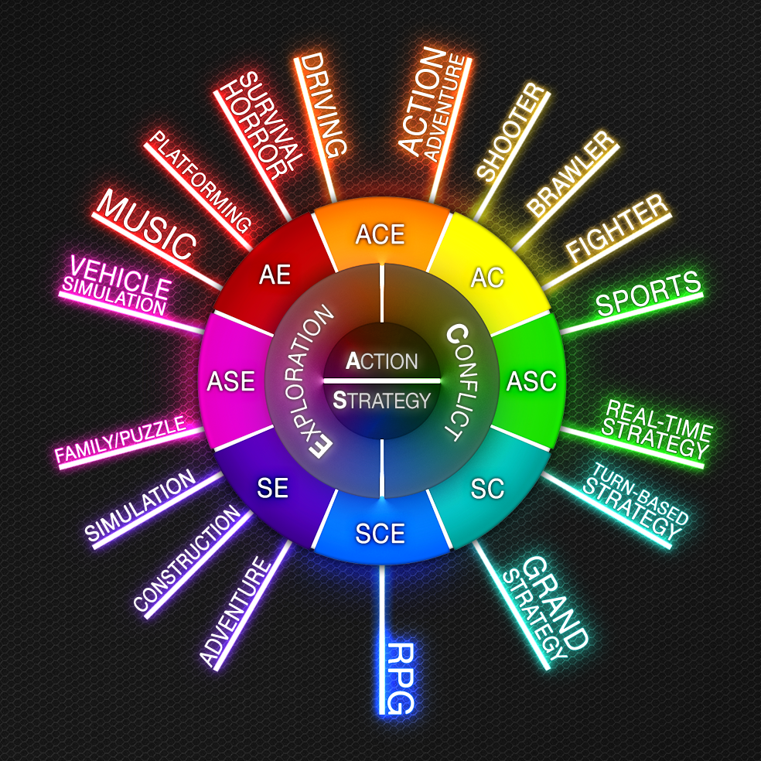
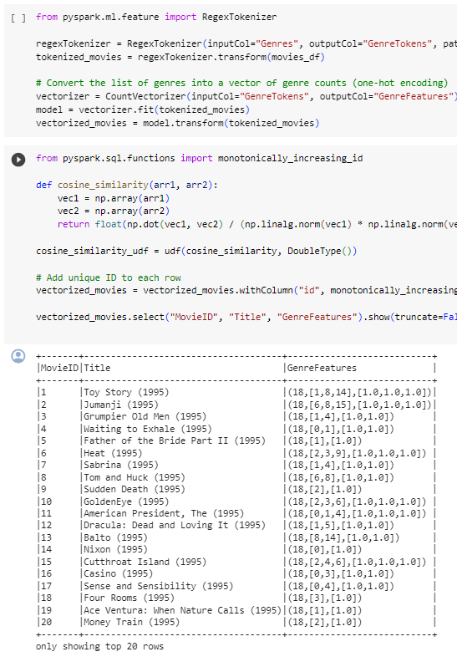
GENRE BASED FILTERING
Genre-based filtering hones in on users' preferences for specific movie genres. By analyzing past genre choices, the system recommends new movies that align with those preferences. For example, if a user frequently enjoys action and adventure genres, the system will prioritize suggesting movies within those categories.
This Photo by Unknown author is licensed under CC BY-SA.

Slide 12

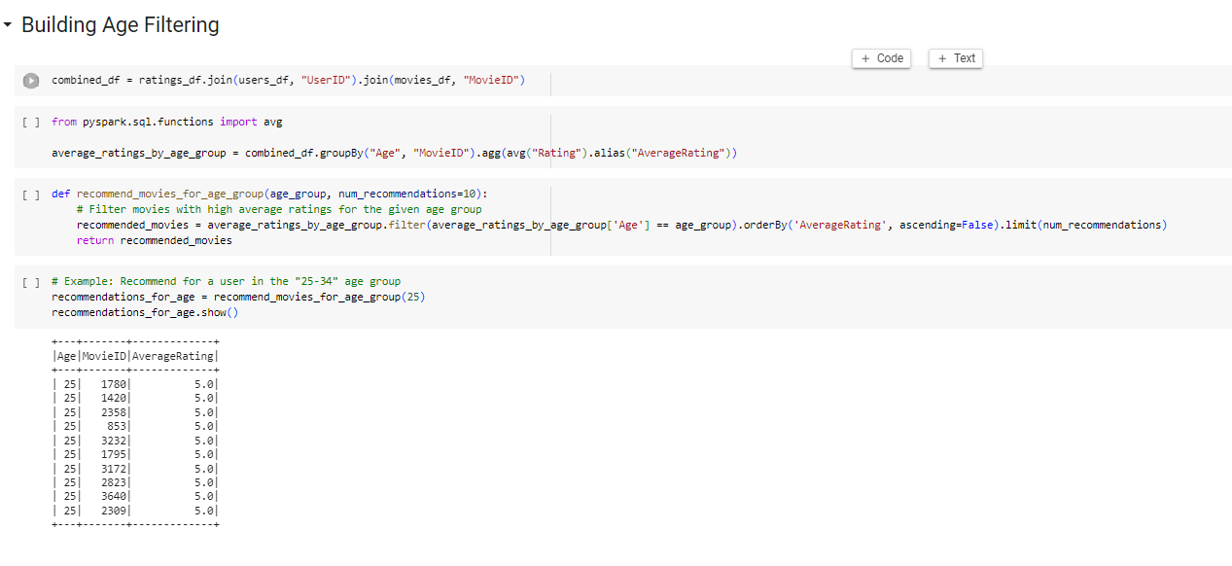
AGE BASED FILTERING
Age-based filtering customizes recommendations by considering the user's age demographic. Users are categorized into different age groups, and content is classified based on its suitability or relevance to specific age ranges. This ensures that content suggestions are age-appropriate and resonate with the interests and preferences associated with different life stages.

Slide 13

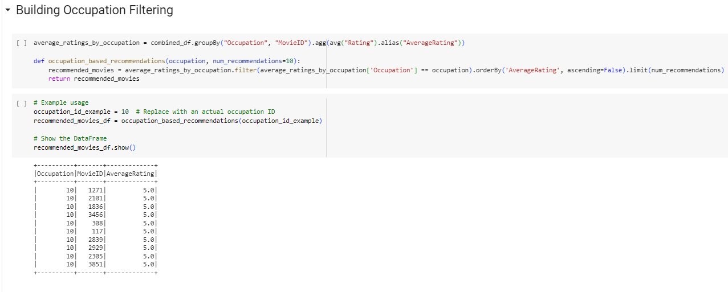
OCCUPATION BASED FILTERING
Occupation-based filtering tailors content recommendations based on the user's professional background. Users are categorized according to their occupations, and content is classified based on its relevance to specific professions. This type of filtering ensures that recommendations align with users' professional interests, offering content that is not only personalized but also professionally relevant.

Slide 14

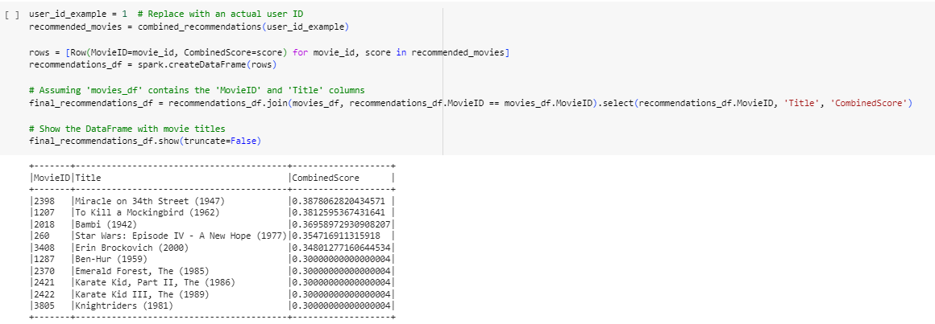
Weighted Hybrid Approach for Optimal Movie Recommendations:
Our commitment to delivering precision and personalization in movie recommendations culminates in a sophisticated weighted hybrid approach. We seamlessly integrate four filtering models—Collaborative, Content-Based (Genre), Age-Based, and Occupation-Based—each contributing unique dimensions to our recommendation system.
Model Weights: To craft a harmonious blend that caters to the diverse preferences of our users, we assign specific weights to each filtering model. The weighted approach allows us to fine-tune the influence of each dimension, ensuring a balanced and nuanced recommendation. The assigned weights are as follows:
Collaborative: 40%
Content-Based (Genre): 30%
Age-Based: 20%
Occupation-Based: 10%

Slide 15


